Slide 1
Utah Monetary Summit
Tom Selgas Monetary Policy Expert United States Bill of Rights Foundation

Slide 2
Acknowledgements
Dr. Edwin Vieira, Jr., PhD, J.D.
Bernard Lietaer
James Turk
Dr. Larry Parks, PhD

Slide 3
Why are we here?
We see the end of the latest era of Fiat Currency
Debt does not produce value or savings it produces chaos;
We see the end of Western Civilization
Economic collapse, political upheavals, and massive civil unrest
We see the need for an Alternate Currency
Our founders understood the necessity of alternate currency’s and allowed the states to use any gold and silver coin [or bullion, see Bronson v. Rodes, 74 US 229, 245-246] (1869) as tender in payments of debt.

Slide 4
Three Key Points
There is a structural cause to the ongoing financial crisis
Growing unemployment is a consequence
A structural solution is available to solve these problems now and into the future

Slide 5
Evidence for Structural Cause?
This is the biggest, but not the first crisis
In the last 25 years (source World Bank)
96 previous banking crises
176 monetary crises

Slide 6
Complexity Theory
Breakthrough: Sustainability is measurable with a single metric
The optimal balance between “efficiency” and “resilience”.

Slide 7
Balance in Natural Networks
Resilience
Efficiency

Slide 8
(In) Balance in Our Financial Network
Efficiency
Resilience

Slide 9
Complex Networks
Efficiency and Resilience are functions of 2 structural variables: diversity and interconnectivity
They are independent from what is being processed in network
Biomass in an ecosystem
Electrons in electrical circuit
Information in immune system
Money in an economy …

Slide 10
Structural Solution
Alternative currencies structurally diversify our medium of exchange – provide for greater resilience
Alternative currency = a standard medium that circulates in parallel with nationalistic or “conventional” money
Examples: Theme park tokens and script (Disney Dollars) circulate within a community.
Alternative currencies link unmet needs with unused resources

Slide 11
“Usefulness” of Alternative Currency
Fact: 70-90% of private employment is generated by Small and Medium sized Businesses
Problem:
Small and medium sized businesses are pressured to pay quickly (e.g. 30 days)
But get paid slowly (e.g. +90 days)
Banks uninterested in providing bridge financing
Solution:
State sanctioned Alternative Currency
Bridge financing using the alternative currency

Slide 12
Benefits to the State that implements a Sound Alternative Currency System
Increased capital flow from all over the world
Reduction in unemployment
Increased revenues and fiscal longevity

Slide 13
State Policy Makers should recognize
Most cost-effective support for employment by governments: Accept Alternative Currency Units for payment of taxes
Uruguay & Northern Brazil success stories
Produces additional income to governmental entities that accept them.
Alternative Currencies are now where Open Source software and Microfinance were +10 years ago …

Slide 14
Choosing the right Alternative Currency
Fiat Legal Tender
Pro: relatively cheap to implement
Con: dishonest, ultimately hyper-inflates
Gold and Silver Coin
Pro: honest, retains value
Con: expensive to implement
Electronic Gold and Silver bullion or coin
Pro: honest, retains value, cheap to implement
Con: requires frequent audits (~quarterly)

Slide 15
Facts about Fiat Currency
No currency in history has lasted longer than 42 years after its intrinsic backing has been abandoned. John Tamny, 9/9/2010¹
It was 40 years ago (8/15/1971) that President Nixon severed the Federal Reserve Note’s link to gold.
The Continental was America’s first fiat currency and it only lasted 6 years.
The graduated income tax system has allowed modern fiat currencies, such as the Federal Reserve Note, to last ~40+ years
1: http://www.forbes.com/2010/09/07/dollar-currency-gold-standard-2020-opinions-columnists-john-tamny.html

Slide 16
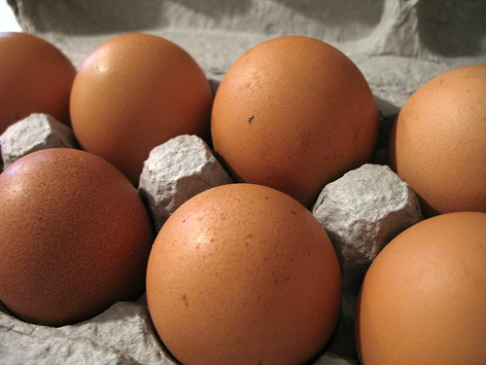
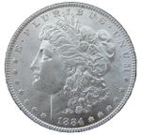
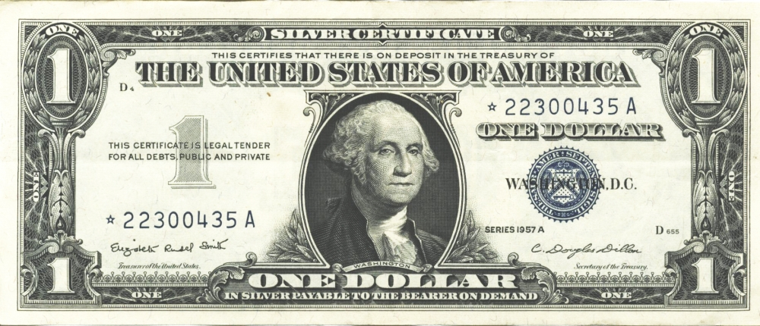
What is the effect of using fiat legal tender?
Property
=
# Egg Cartons (Brown Eggs)
=
# Lawful Money ($)
# Legal Tender $
1957
=
=
=
U.S. Silver Certificate
1,600 Sq. Ft. Home
~37,700
($)13,500
$13,500
=
No Lawful
Money Available
1982
Fed. Res. Bank Note
1,600 Sq. Ft. Home
~37,700
“$85,400”
2007
=
=
=
Fed. Res. Bank Note
1,600 Sq. Ft. Home
~37,700
($)13,500
“$175,000”
Notes:
So now lets look at the effects of using unconstitutional legal tender Federal Reserve Notes.
Because Federal Reserve Notes have no value in or of themselves and no intrinsic value, they can be inflated in such a manner to make you believe that you made a gain or an accession to wealth, when in fact you had no such gain at all.
Because Federal Reserve Notes have no set fixed value, they can be used to “quietly” steal your wealth with the perception that you had a gain.
Because Federal Reserve Notes have no known or calculable value, they can be used to deceive the citizens into believing they will receive future benefits, such as social security, at today’s purchasing power.

Slide 17
Fiat Currency Robs Capital!
Property
=
# Egg Cartons
(Brown Eggs)
=
# Lawful Money ($)
# Paper Tender $
Buy
1957
=
=
=
U.S. Silver Certificate
1,600 Sq. Ft. Home
~37,700
($)13,500
$13,500
Sell
2007
=
=
=
Fed. Res. Bank Note
1,600 Sq. Ft. Home
~37,700
($)13,500
$175,000
No Cartons of Eggs Gain
No Lawful Money Gain
Federal Reserve Note
“Gain” of $161,500
No Gain No Tax Due
No Gain No Tax Due
Alleged Tax Due
~FRN$55,000
After FRN Tax results in a
Physical Egg Carton Loss of
11,922 Cartons of Eggs
After FRN Tax results in a
Lawful Money Property Loss of ($)4,269
The purported Fiat Currency “Gain” is actually a “quiet theft” in that
it results in a physical property loss with the perception of an actual gain.
Notes:
So now let’s look at an example.
What are the effects of using unconstitutional legal tender notes?
An unrealized loss of capital and property;
A loss of real value;
The loss of the full economic impact of automation.
Brown Egg Data:
EGG ECONOMICS UPDATE reports by Donald Bell, Poultry Specialist (emeritus), University of California , Riverside, CA 92521
http://www.ams.usda.gov/poultry/mncs/ShellEgg/USDAEGGMARKETNEWSREPORT.html
http://www.pathtoinvesting.org/interactive/inflation/simulation_inflation.htm

Slide 18
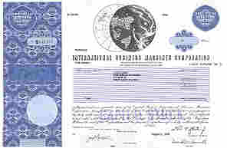
Fiat Currency Results in Quiet Theft!
Stock
=
# Egg Cartons
(Brown Eggs)
=
# Lawful Money $
# Legal Tender $
Buy
1962
=
=
=
U.S. Silver Certificate
4 Shares IBM Stock
~5,424
$1,942.00
$1,942.00
Sell
2007
=
=
=
Fed. Res. Bank Note
300 Shares IBM Stock after splits
~6,571
$2,338.56
“$30,501.00”
17% Gain in Eggs Cartons
17% Lawful Money Gain
Federal Reserve Note
“94% Gain” of $28,559
Tax Due ~172 Egg Cartons
Tax Due $59.48
Alleged Tax Due (15%)
~FRN$4283.85
After FRN Tax results in a
Physical Egg Carton Loss of
923 Cartons of Eggs
FRN Inflation results in a
83% tax rate or $328.45 of the
$396.56 of the purported gain
The purported Paper Tender “Gain” is actually a “quiet theft” in that
it results in an 83% tax rate with the perception of 15% tax rate.
IBM Stock Splits: 1964-05-18 [5:4], 1966-05-18 [3:2], 1968-04-23 [2:1], May 29, 1973 [5:4], Jun 1, 1979 [4:1], May 28, 1997 [2:1], May 27, 1999 [2:1]
Notes:
So now let’s look at an example.
What are the effects of using unconstitutional legal tender notes?
An unrealized loss of capital and property;
A loss of real value;
The loss of the full economic impact of automation.
Brown Egg Data:
EGG ECONOMICS UPDATE reports by Donald Bell, Poultry Specialist (emeritus), University of California , Riverside, CA 92521
http://www.ams.usda.gov/poultry/mncs/ShellEgg/USDAEGGMARKETNEWSREPORT.html
http://www.pathtoinvesting.org/interactive/inflation/simulation_inflation.htm

Slide 19
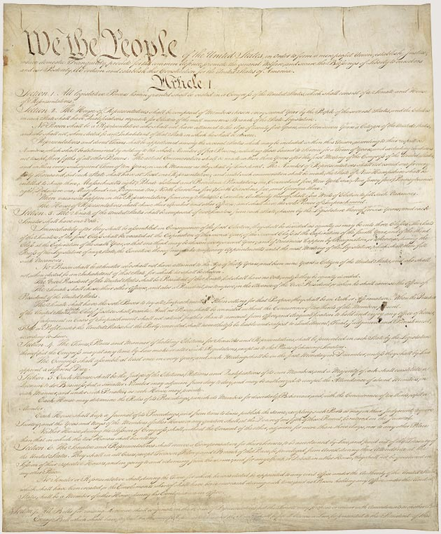
The Constitution foresaw the need for Alternative Currency Structural Solution
Article I Section 8, Clause 5
[The Congress shall have Power] To coin Money, regulate the Value thereof, and of foreign Coin, and fix the Standard of Weights and Measures;
Article I Section 9, Clause 1
… a Tax or duty may be imposed on such Importation, not exceeding ten dollars for each Person.
Article I Section 10, Clause 1
No State shall … make any Thing but gold and silver coin a Tender in Payments of Debts.
Amendment VII
In Suits at common law, where the value in controversy shall exceed twenty dollars, the right of trial by jury shall be preserved, and no fact tried by a jury, shall be otherwise re-examined in any Court of the United States, than according to the rules of the common law.
Notes:
It is rather ironic that during the first 124 years of our Republic’s existence (1789 – 1913), it was well understood by the general public that the word “Dollar” means a pure metallic silver coin of a known fixed unit of measurement for money, value and wealth.
Over the next 55 years (1913 – 1968), the definition of the Dollar was slowly removed from public education, dictionaries and our court rooms to the point that in 1968 Congress unconstitutionally eliminated the fundamental and necessary requirement of silver from the “public” definition of the word “Dollar”. Hence our constitutionally guaranteed fixed standard unit of measure of money and wealth was hijacked.
Finally, on 15 August 1971, President Richard Nixon unconstitutionally terminated redemption of Federal Reserve Notes in gold internationally, ending the connection between the Federal Reserve System and any “constitutional” money whatsoever.

Slide 20
The Supreme Court ruled on the validity of the Structural Solution
Bronson v. Rodes, 74 US 229, 245-246 (1869)
United States v. Marigold, 50 U.S. 560, 567-568 (1850)
Payment of money is delivery by the debtor to the creditor of the amount due. A contract to pay a certain number of dollars in gold or silver coins is, therefore, in legal import, nothing else than an agreement to deliver a certain weight of standard gold, to be ascertained by a count of coins, each of which is certified to contain a definite proportion of that weight. It is not distinguishable, as we think, in principle, from a contract to deliver an equal weight of bullion of equal fineness. It is distinguishable, in circumstance, only by the fact that the sufficiency of the amount to be tendered in payment must be ascertained, in the case of bullion, by assay and the scales, while in the case of coin it may be ascertained by count.
“They [Congress] appertain rather to the execution of an important trust invested by the Constitution, and to the obligation to fulfill that trust on the part of the government, namely, the trust and the duty of creating and maintaining a uniform and pure metallic standard of value throughout the Union. The power of coining money and of regulating its value was delegated to Congress by the Constitution for the very purpose, as assigned by the framers of that instrument, of creating and preserving the uniformity and purity of such standard of value

Slide 21
The Supreme Court ruled on taxation in the Structural Solution
Lane County v. Oregon, 74 US 71, 78 (1869)
Hagar v. Reclamation District No. 108, 111 U.S. 701, 706-07 (1884)
If, therefore, the condition of any State, in the judgment of its legislature, requires the collection of taxes in kind, that is to say, by the delivery to the proper officers of a certain proportion of products, or in gold and silver bullion, or in gold and silver coin, it is not easy to see upon what principle the national legislature can interfere with the exercise, to that end, of this power, original in the States, and never as yet surrendered. If this be so, it is, certainly a reasonable conclusion that Congress did not intend, by the general terms of the currency acts, to restrain the exercise of this power in the manner shown by the statutes of Oregon.
The acts of Congress making the notes of the United States a legal tender do not apply to involuntary contributions exacted by a State, but only to debts, in the strict sense of that term, that is, to obligations for the payment of money founded on contracts, express or implied … First, that it was the right of each State to collect its taxes in such material as it might deem expedient, either in kind, that is to say, by a certain proportion of products, or in bullion, or in coin, the court observing that the extent to which the power of taxation of the State should be exercised, the subjects upon which it should be exercised, and the mode in which it should be exercised were all equally within the discretion of its Legislature, except as restrained by its own constitution and that of the United States

Slide 22
Alternative Currency System Requirements
Any alternative currency system requires multiple third party outside auditors
Any alternative currency must be based upon honest weights and measures “to prevent its debasement and expulsion, and the destruction of the general confidence and convenience”
Any alternative currency system cannot be monopolized by a private entity (e.g. The Federal Reserve Banking system)

Slide 23
Conclusion for State Lawmakers
The Constitution of the United States authorizes the use of a Gold and Silver based alternative currency system, Article I Section 10, Clause 1
An Electronic Gold and Silver bullion currency system is constitutionally authorized, Bronson v. Rodes, 74 US 229, 245-246 (1869)
An Electronic Gold and Silver bullion alternative currency system provides the best cost benefits for both the State and her citizens.

Slide 25
Backup Slides

Slide 26
Final Remarks
Edwin Vieira, Jr, PhD, J.D.: There is no question that this "banking" (or, more descriptively, "financial racketeering") group has been, for a long time, the dominant economic, political, and social force in Western Civilization, and more recently in world civilization. But the cracks in its facade are already widening to a dangerous degree: Its paper-money and credit schemes are in the final stages of Ponzi self-destruction. Its militaristic imperialism has arrived at the point of "overstretch ." Its "social programs" to keep the masses content with "bread and circuses" are proving too expensive to maintain while funding the other major line-items of the imperialistic agenda. Its political and economic fronts of "democracy," "free elections," "two parties," "the rule of law," "freedom of speech," "free markets," "free trade" et cetera ad nauseum, are being exposed as frauds. So the game seems to be up.
http://www.lewrockwell.com/wile/wile30.1.html

Slide 27
What are our choices?
We can wait for the people who created the problem to give us their next best solution
We can look to our own history and restore our Constitutional Lawful Money system
We can do nothing and see what happens
History show that if we sit back and do nothing we will see the demise of Western Civilization as we know it

Slide 28
Facts about Alternative or Dual Currencies
Europe had dual currency systems during the late medieval and early Renaissance period.
Modern Europe demonstrated that it is possible to run dual currency systems for 24-36 months to transition into a new currency.

